Slide 1
Outcome Survey Posts

Slide 2
New Test

Slide 3
Facts: 3 each

Slide 4


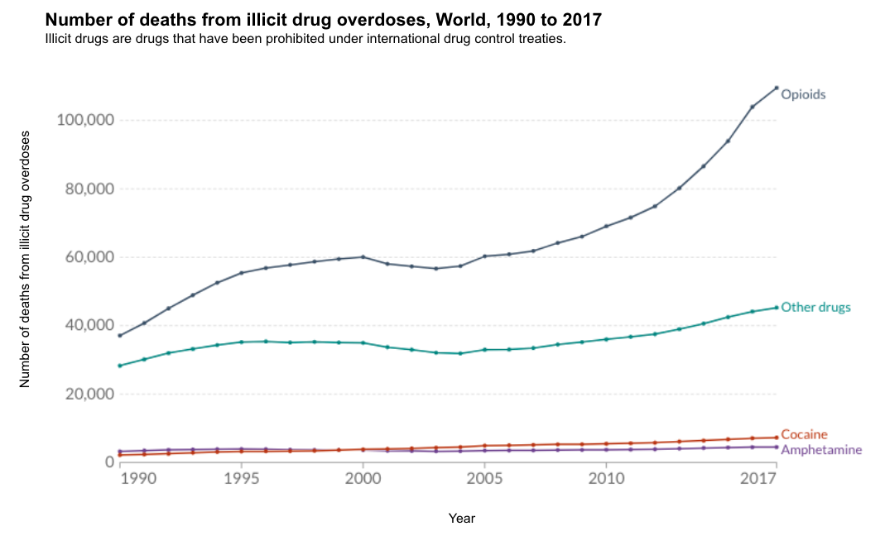
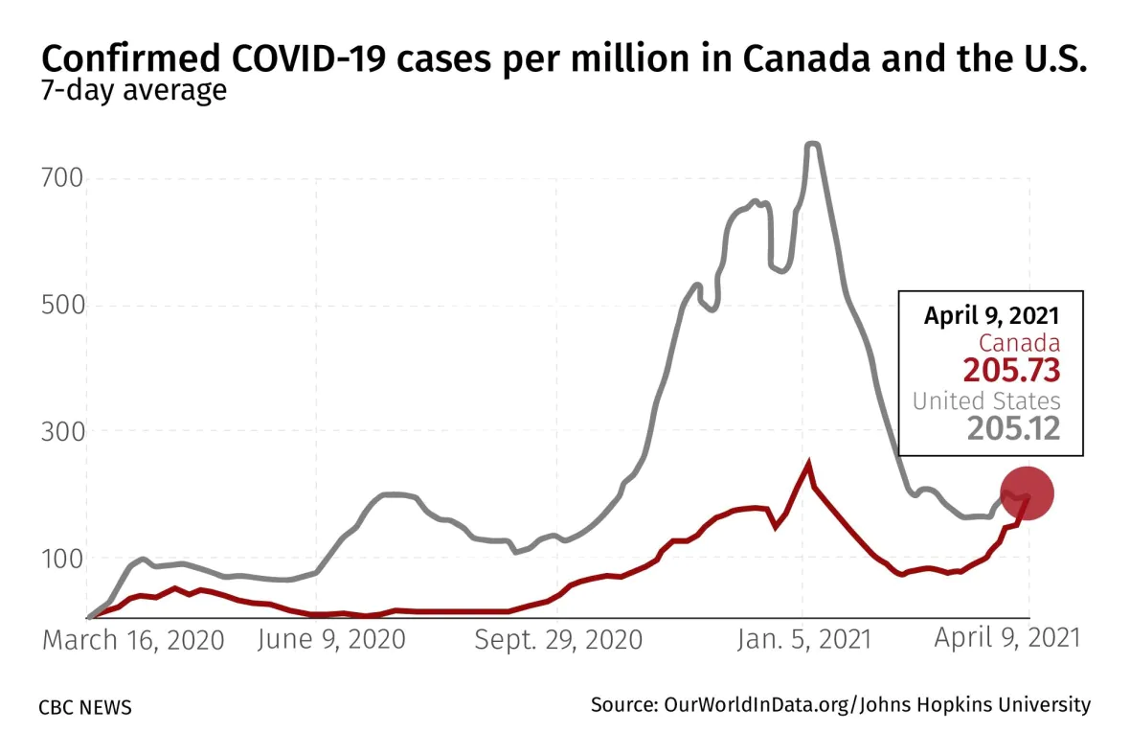
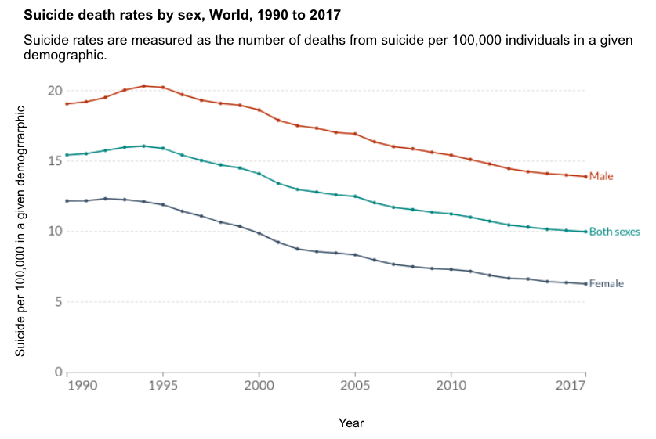

True Charts, Neutral Tone
Topics: opioids, death, drugs
JH Public Health
4 hrs
JH Public Health
4 hrs
Global overdose deaths from opioids more than doubled from 1990 until 2017. This is an important issue that needs more attention.
This graph shows the how covid cases in Canada caught up to the US counts per million in April 2021. I worry about my parents who have been living in Canada since the lockdowns.
Nila
3 hrs

Slide 5
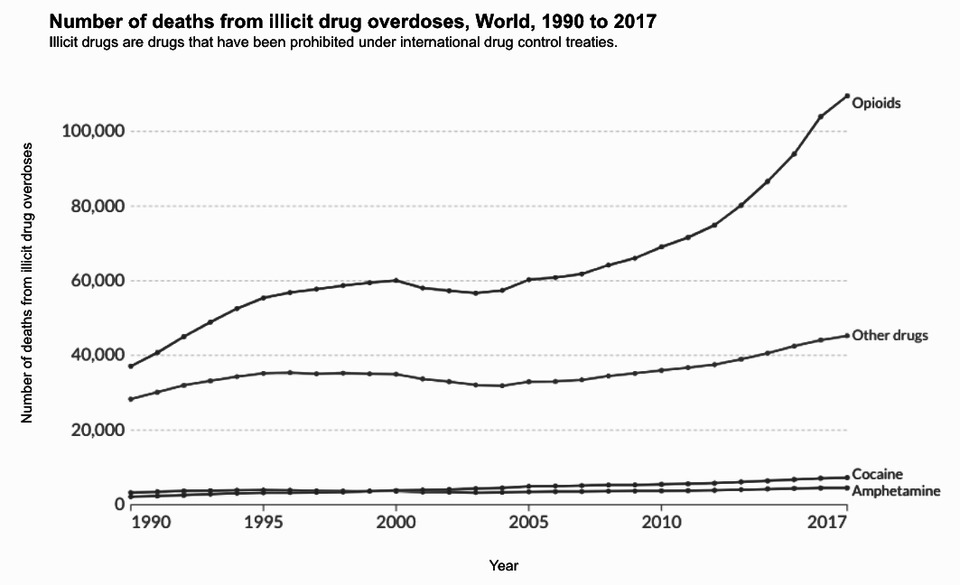
True Charts, Neutral Tone
Number of deaths from illicit drug overdoses, World, 1990 to 2017
Opioids
Number of deaths
Other drugs
Cocaine
Amphetamine
Year

Slide 6
True Charts, Neutral Tone
Number of cases (per million)
Date

Slide 7

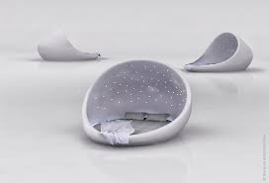
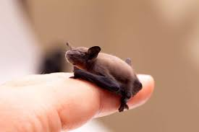
Truths
Sunne
4 hrs
Sunne
4 hrs
...
...
With a head-to-body length of 1.14 to 1.29 inches, the bumblebee bat is the smallest mammal in the world. To see this tiny bat for yourself, you’d have to visit one of a select few limestone caves on the Khwae Noi River in Kanchanaburi Province of southwest Thailand.
In 1986, eleven Russian men spent 370 days lying down in bed. The experiment was to help with future space expeditions, because a year in bed simulated weightlessness.

Slide 8



Truths
Anna
4 hrs
Anna
4 hrs
...
...
I read an article about how McDonald’s once made bubblegum-flavored broccoli. Unsurprisingly, the attempt to get kids to eat healthier didn’t go over well with the child testers, who were “confused by the taste.”
My sister is working on better solutions to solving obesity in communities without access to healthy food. It’s been shown that being overweight may shorten your life, in some cases by a decade or more.

Slide 9

Tom
4 hrs
...

Slide 10
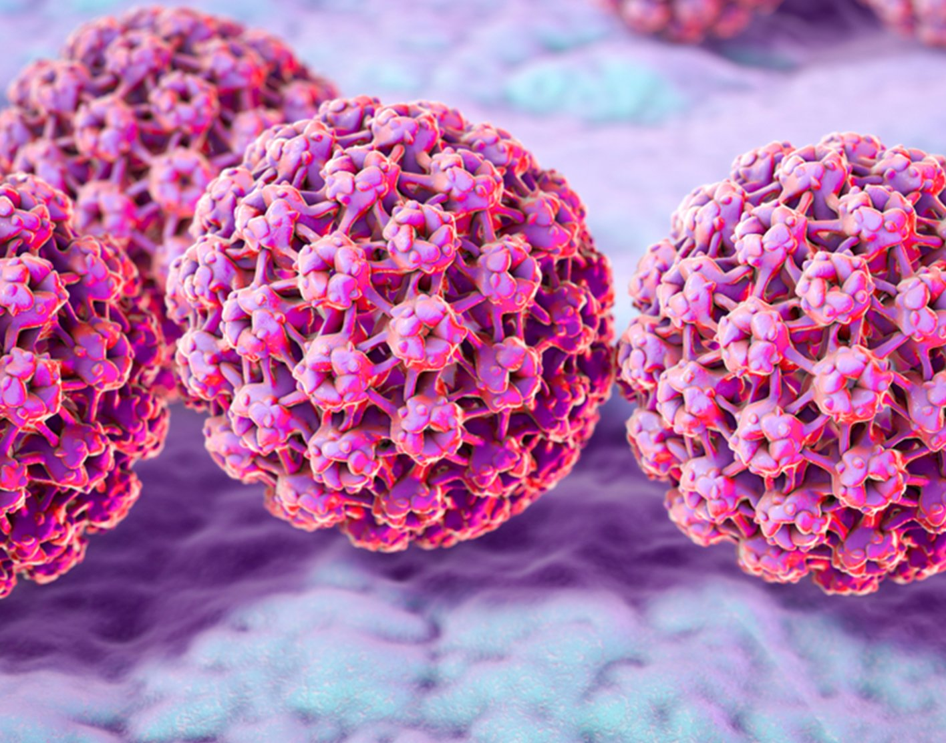

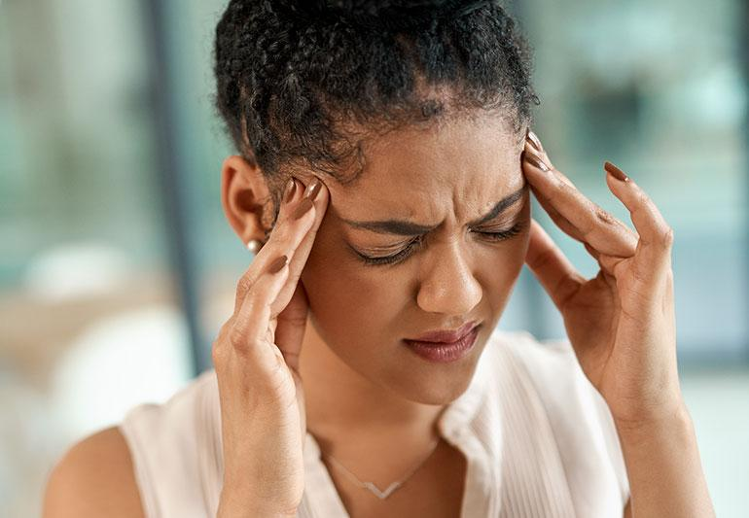

Truths
Sunne
4 hrs
Sunne
4 hrs
...
...
Aloe vera has a lot of benefits as a topical medication, including treatment for first and second degree burns. Some reviews have shown that it has faster healing times than many conventional medicines.
Contagious yawns? Scientists trained a tortoise to yawn in order to research social cognition in tortoises. The team taught the tortoise to yawn on command, but they didn't observe contagious yawning when they had the tortoise around other members of its species.

Slide 11
Truths
Anna
4 hrs
Anna
4 hrs
...
...
We need better solutions to solving obesity in communities without access to healthy food. It’s been shown that being overweight may shorten your life, in some cases by a decade or more.
Scientists discovered that it is just as easy to swim in syrup as it is to swim in water. In order to conduct the experiment, they filled a 25 meter swimming pool with a liquid that is twice as thick as water, and it turns out that you can swim in it just fine!

Slide 12
Misinfo Tactics

Slide 13

Misleading Graphs
Alexandra
4 hrs
Alexandra
4 hrs
1,576,674
NO
8,430,222
YES
Support for unions has significantly decreased over the years. However, this new poll shows just how many workers actually support unionizing.
Recent polling has shown how most people think that britain should leave the EU.
Topics: Vaccine, Children

Slide 14

Misleading Graphs

Slide 15
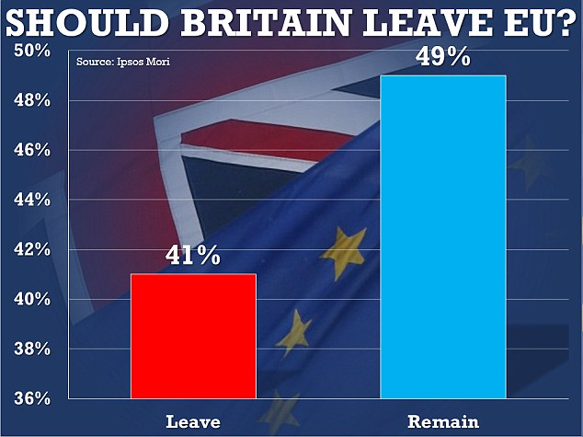
Misleading Graphs

Slide 16


Misleading Graphs
Ali_1958
4 hrs
Ali_1958
4 hrs
The unemployment rate under president obama has been relatively the same in 2017.
There’s been an increase in people receiving federal welfare in the US from 2009 to 2011.
Topics: Vaccine

Slide 17



False Equivalence
Lindsay Dunne
4 hrs
Lindsay Dunne
4 hrs
...
...
Trying to quit smoking? You should try the Lharbanti Meditation technique that has been scientifically proven to help thousands of people overcome their addiction to video games.
Studies have shown that students who attend schools with expansive music programs tend to perform much higher on standardized testing. If your child is struggling with grades, enroll them in the Von Gesualdo music program!
David
4 hrs

Slide 18

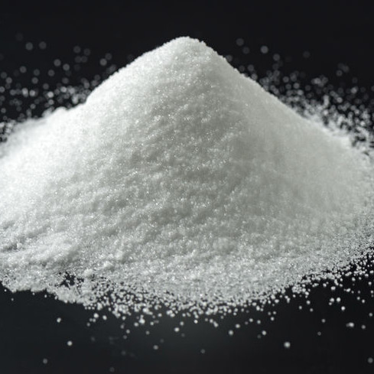
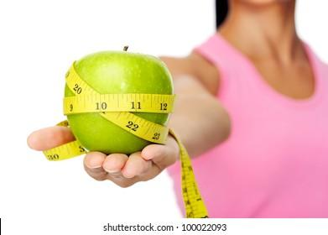
Anecdotes
AJ
4 hrs
AJ
4 hrs
...
...
My grandmother smoked a pack of cigarettes a day and ate whatever she wanted. She outlived my grandfather who restricted himself to a vegetarian diet. This shows that the secret to longevity is to live freely, doing what you enjoy.
Last month, my friend recommended a diet plan focused around apples to prevent migraines. I have not had a headache since starting this diet. Who knew that apples were the secret to preventing headaches!

Slide 19

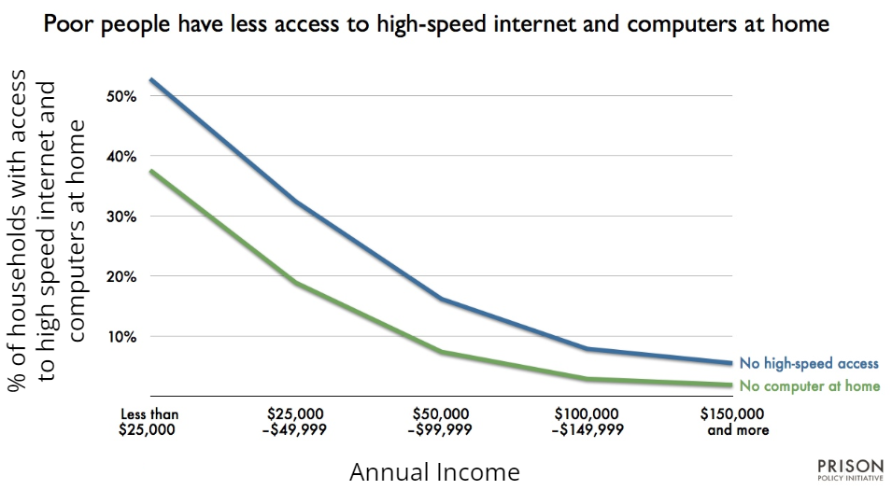
Combined
Lindsay Dunne
4 hrs
Tom
4 hrs
...
I grew up with slow internet speeds and now work at a minimum wage job. Parents should set their children up for success by subscribing to high speed internet and getting the fastest computer they can afford.
Tetris was one of the best selling video games in 2021. My younger brother started playing it last year and said it has improved his concentration. High schools should offer a gaming class to help students develop concentration and improve their test taking performance.

Slide 20
Combined

Slide 22
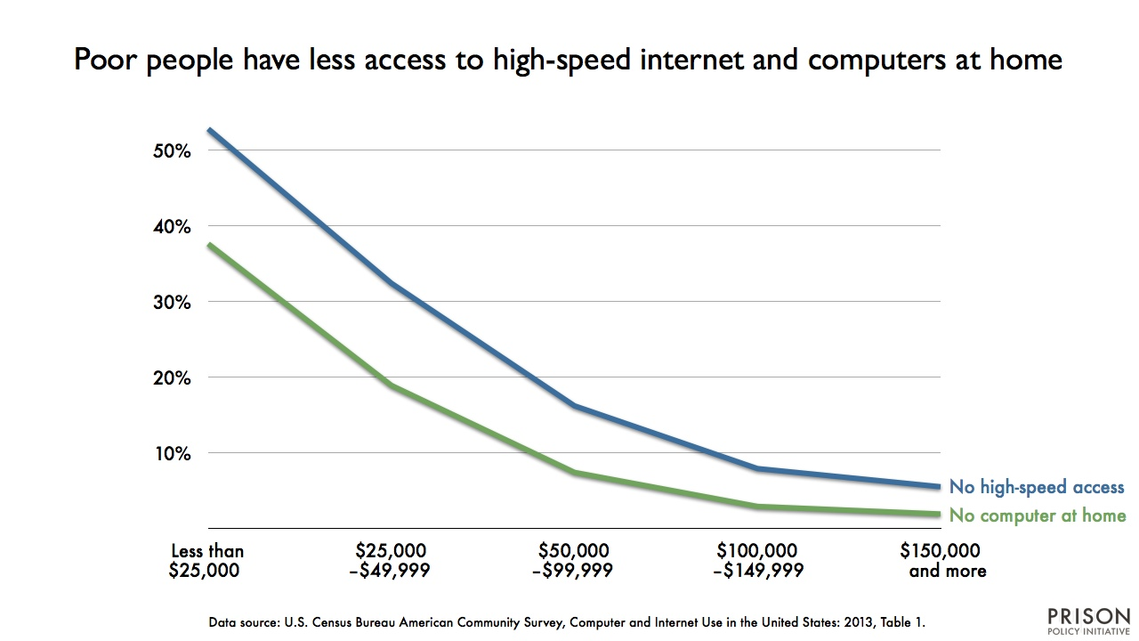

False Equivalence
Lindsay Dunne
4 hrs
Lindsay Dunne
4 hrs
...
Investing in the stock market is really no different from buying a lottery ticket or playing a slot machine, it’s all just a gamble on some random choice. The online JackpotZNow slot machine will give you the best odds, try it now.
Studies show that lower income households have less access to high-speed internet and computers. I agree with the findings since my brother had the highest paying job and owned the fastest smartphone in the house. I recommending buying the newest smartphone that is faster than the average computer to increase your chances to earn more money!

Slide 23
Pre-Test

Slide 24
Lindsay Dunne
4 hrs
...
The common cold is not a natural virus. We assume it has always been around because we are used to it, but it was first discovered by the US military in 1948.

Slide 25
Javier
7 hrs
...
Don’t be duped by the profit-seeking of big pharmaceutical companies. Aloe vera often fixes burns much faster than conventional medicine.

Slide 26
Indrajeet
4 hrs
...
Very important! One of my best friends, who is a doctor, just published a article about how a diet rich in carrots can prevent diabetes. What good news!

Slide 27

Sunne
4 hrs
...
It’s a myth that your heart briefly stops when you sneeze. The fact is, sneezing makes the pressure in our chest change. These small changes can alter blood flow, changing the rhythm of your heartbeat. So even if it feels like your heart skips a beat when you sneeze, it actually doesn’t.

Slide 28
JohnSands44
4 hrs
...
They continue silencing us and what we know — Dentists are using dangerous ingredients when they clean your children’s teeth which can lead to a lower IQ.
#savethechildren #knowthetruth #medical choice

Slide 29

Jessica
4 hrs
...
So we finally know why they want us to get flu vaccines every year. It’s all about collecting our DNA and adding it to their databases so they can easily track and control us.
#DNAfarming #jointheresistance
#wakeup

Slide 30
Alexandra
4 hrs
Do you think it’s a good idea to vaccinate your children?
1,576,674
NO
8,430,222
YES
NEW POLL SHOWS MOST PARENTS AGAINST VACCINES
Support for vaccines has significantly decreased over the years. A new poll shows just how many parents actually support vaccines for children.

Slide 31
JH Public Health
4 hrs
Global overdose deaths from opioids more than doubled from 1990 until 2017.

Slide 32
Post-Test

Slide 33
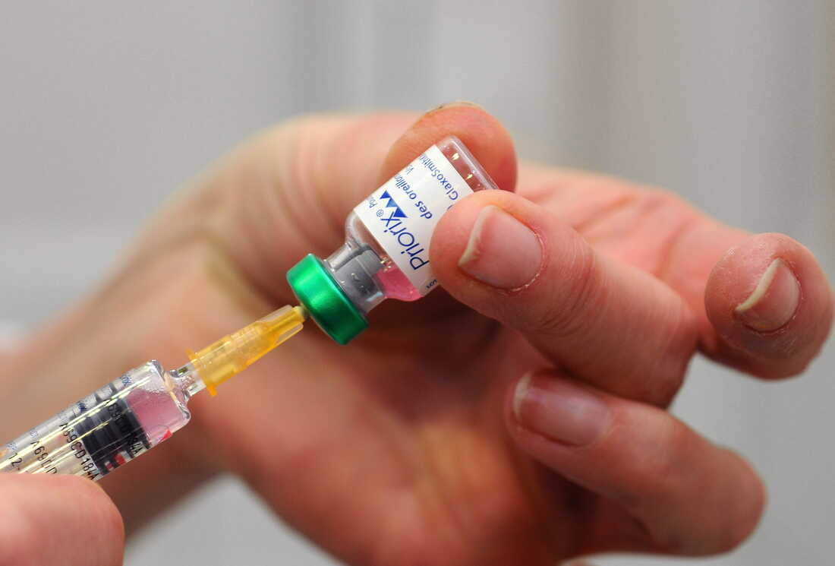
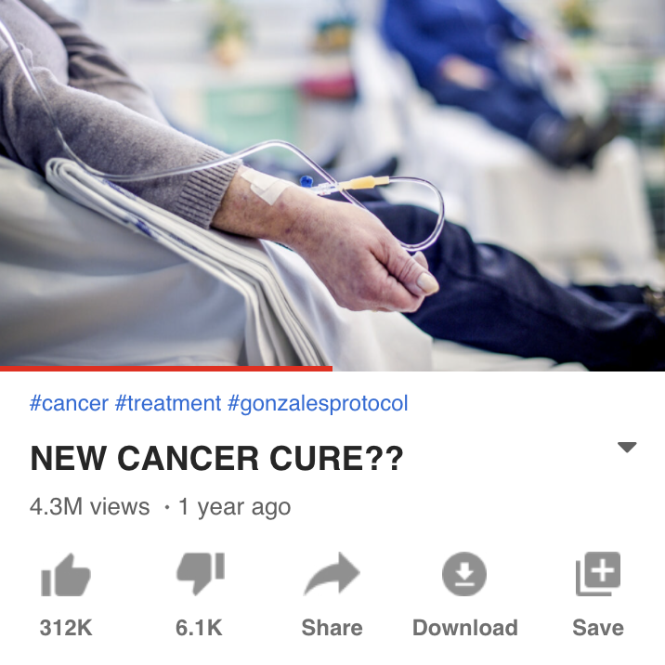
David
4 hrs
...
Autism is a relatively new phenomenon. There are no known records of it before 1943, when scientist Leo Kranner first described it. Research funded by pharmaceutical companies has attempted to discredit links between vaccines and autism, but the evidence doesn’t lie.

Slide 34


Lolita
4 hrs
MYTH: Sitting close to the TV does NOT damage your eyes, but it may cause eyestrain.
5 popular myths debunked!
Medical doctor Yasmin Ahmadi helps debunk some common myths about health and wellness.

Slide 35
Oliver
8 hrs
...
Doctors would NEVER tell you this, but you don’t really need to avoid alcohol. when taking antibiotics. Only certain antibiotics react poorly with alcohol.

Slide 36
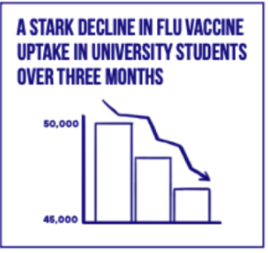
Ali_1958
4 hrs
Look at this. The chart speaks for itself. They have been lying to us but they can’t hide these statistics.

Slide 37
AJ
4 hrs
...
My friend is a nurse and she just told me about a BRAND NEW piece of research that will be released soon proving that calories have nothing to do with weight or weight loss.

Slide 38
Trushar
4 hrs
...
They are hiding the truth from you and putting our children in danger. Give your child a tablespoon of garlic and honey each day to prevent measles, not any of the mysterious drugs doctors want to feed to our kids.

Slide 39

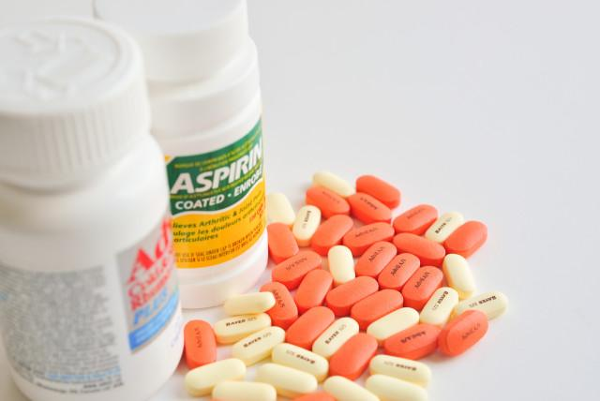

Shirley
4 hrs
...
FACT: 8% of all kids 5-10 have dangerous side-effects from the Moderna vaccine. Do your research and protect your children.

Slide 40
Nila
3 hrs
This graph shows the suicide death rates by sex, globally from 1990-2017. Since 1990, men have shown a higher propensity towards suicide than women.

Slide 41
End of Test

Slide 42
Overview
These slides are grouped by similar tactics/topics.
Each slide contains 2 similar posts so that we have 1 post for pre-test and 1 post for post-test.
3 Facts, 2 Emotional Misinfo, 3 Tactical Misinfo

Slide 43
Old Slides

Slide 44

Correct Equivalence
Lolita
4 hrs
Anna
4 hrs
In 2012, a group of psychologists found that "leaning to the left makes the Eiffel Tower seem smaller." When people are leaning, their ability to estimate things like quantity and size is affected because we tend to assume that smaller things go on the left and larger things go on the right.
...
Scientists discovered that it is just as easy to swim in syrup as it is to swim in water. In order to conduct the experiment, they filled a 25 meter swimming pool with a liquid that is twice as thick as water, and it turns out that you can swim in it just fine!

Slide 45
True Charts, Neutral Tone
Topics: opioids, death, drugs
Topics: Gender, Suicide, mental health
JH Public Health
4 hrs
Nila
3 hrs
Global overdose deaths from opioids more than doubled from 1990 until 2017.
This graph shows the suicide death rates by sex, globally from 1990-2017. Since 1990, men have shown a higher propensity towards suicide than women.

Slide 46
Misleading Graphs

Slide 47
Conspiracy Theories
Lindsay Dunne
4 hrs
David
4 hrs
...
...
The common cold is not a natural virus. We assume it has always been around because we are used to it, but it was first discovered by the US military in 1948.
Autism is a relatively new phenomenon. There are no known records of it before 1943, when scientist Leo Kranner first described it. Research funded by pharmaceutical companies has attempted to discredit links between vaccines and autism, but the evidence doesn’t lie.
Topics: virus, cold, bioweapons
Topics: vaccine, autism, children(?)

Slide 48
Insider Information
Indrajeet
4 hrs
AJ
4 hrs
...
...
Very important! One of my best friends, who is a doctor, just published a article about how a diet rich in carrots can prevent diabetes. What good news!
My friend is a nurse and she just told me about a BRAND NEW piece of research that will be released soon proving that calories have nothing to do with weight or weight loss.
Topics: diabetes (weight)
Topics: obesity (weight)

Slide 49
Emotional Truths
Javier
7 hrs
Oliver
8 hrs
...
...
Don’t be duped by the profit-seeking of big pharmaceutical companies. Aloe vera often fixes burns much faster than conventional medicine.
Doctors would NEVER tell you this, but you don’t really need to avoid alcohol. when taking antibiotics. Only certain antibiotics react poorly with alcohol.
Topics: antibiotic, alcohol
Topics: Big Pharma, aloe vera, Natural remedies

Slide 50
Myth Debunking
Lolita
4 hrs
Sunne
4 hrs
...
MYTH: Sitting close to the TV does NOT damage your eyes, but it may cause eyestrain.
It’s a myth that your heart briefly stops when you sneeze. The fact is, sneezing makes the pressure in our chest change. These small changes can alter blood flow, changing the rhythm of your heartbeat. So even if it feels like your heart skips a beat when you sneeze, it actually doesn’t.
5 popular myths debunked!
Medical doctor Yasmin Ahmadi helps debunk some common myths about health and wellness.
Topics: heart
Topics: eyes

Slide 51
Misinfo Emotions: 2 each

Slide 52
Vaccine Misinfo
Jessica
4 hrs
Shirley
4 hrs
...
...
So we finally know why they want us to get flu vaccines every year. It’s all about collecting our DNA and adding it to their databases so they can easily track and control us.
#DNAfarming #jointheresistance
#wakeup
FACT: 8% of all kids 5-10 have dangerous side-effects from the Moderna vaccine. Do your research and protect your children.
Topics: Vaccine
Topics: Children, Vaccine

Slide 53
Conspiracy Emotions
JohnSands44
4 hrs
...
Trushar
4 hrs
...
They continue silencing us and what we know — Dentists are using dangerous ingredients when they clean your children’s teeth which can lead to a lower IQ.
#savethechildren #knowthetruth #medical choice
They are hiding the truth from you and putting our children in danger. Give your child a tablespoon of garlic and honey each day to prevent measles, not any of the mysterious drugs doctors want to feed to our kids.
Topics: Vaccine, Children
natural remedies
Topics: Children

Slide 54
Extra Slides

Slide 55
New post template
Anna
4 hrs
...
We need better solutions to solving obesity in communities without access to healthy food. It’s been shown that being overweight may shorten your life, in some cases by a decade or more. #healthinequality #foodaccess #healthyeating #obesity #poverty
Topics: obesity, poverty

Slide 56
Overall Topics
Health Topics
Obesity (body health)
Suicide (mental health)
Vitamin, Aloe Vera (medicine)
Death Rate
Migraine (body health)
Virus (Cold) (body health)
Antibiotics (medicine)
Alcohol
Cancer (disease)
Pregnancy (children)
COVID-19
HIV (disease)
Cannabis, Opioid (drugs)
Autism (children)
Eyes, Heart (body health)
Natural Remedies (health condition)
Final Topics
Gender
Vaccine
COVID-19
Children
Drugs & Alcohol
Medicine
Medical Condition
Politics
Religion
Sports
Pets

Slide 57
New post template
Lindsay Dunne
4 hrs
Lindsay Dunne
4 hrs
...
...
A group of researchers claim the common cold is not natural but is manmade, engineered by the US military in 1948 as a bioweapon.
The common cold is not a natural virus. We assume it has always been around because we are used to it, but it was first discovered in humans in 1948. Where did it come from?
Topics: virus, cold
bioweapons

Slide 58
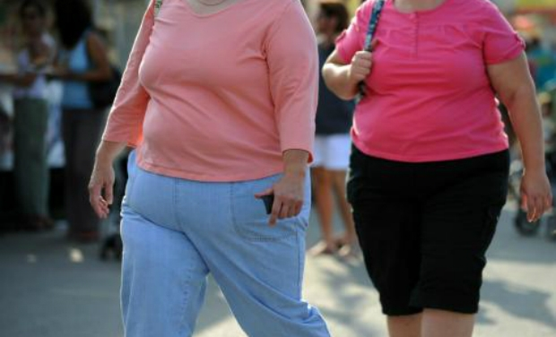

Misleading Graphs
Ali_1958
4 hrs
Ali_1958
4 hrs
...
New statistics show that flu vaccine uptake in university students has plummeted in just the last three months.
Look at this. The chart speaks for itself. They have been lying to us but they can’t hide these statistics.
Topics: Vaccine

Slide 59

New post template
Pooja
4 hrs
Pooja
4 hrs
...
...
Data from the CDC shows that only 7% of recorded covid deaths actually died without other comorbidities. Real covid fatality rates are much smaller than we think.
covid.cdc.gov/covid-data-tr… #covid #coronavirus
Real covid fatality rates are much smaller than we think. Do your own research, all the data is out there for you to make an informed decision. #covid #coronavirus
Topics: COVID, death

Slide 60
New post template
Indrajeet
4 hrs
Indrajeet
4 hrs
...
...
Very important! One of my best friends, who is a doctor, just published a article about how a diet rich in carrots can prevent diabetes. What good news!
Very important! I just read a new article about how a diet rich in carrots can help regulate your glucose levels. This is great news for people who are at risk of diabetes.
Topics: diabetes (weight)

Slide 61
Section 1: “Can people incorporate techniques?”
8 different facts, all true.
16 different posts: a manipulative version and a non-manipulative version of each fact.

Slide 62
New post template
Topics: eyes
Lolita
4 hrs
Lolita
4 hrs
...
MYTH: Sitting close to the TV does NOT damage your eyes, but it may cause eyestrain.
Medical doctor Yasmin Ahmadi helps debunk some common myths about health and wellness.
MYTH: Sitting close to the TV does NOT damage your eyes, but it may cause eyestrain.
5 popular myths debunked!
Medical doctor Yasmin Ahmadi helps debunk some common myths about health and wellness.
CHOOSE EITHER ONE! It’s the same content

Slide 63
New post template
Javier
7 hrs
Javier
7 hrs
...
...
Don’t be duped by the profit-seeking of big pharmaceutical companies. Aloe vera often fixes burns much faster than conventional medicine.
Aloe vera has a lot of benefits as a topical medication, including treatment for first and second degree burns. Some reviews have shown that it has faster healing times than many conventional medicines.
Topics: Big Pharma, aloe vera, Natural remedies

Slide 64
New post template
Oliver
8 hrs
Oliver
8 hrs
...
...
Some antibiotics can make you very sick if taken in combination with alcohol, while others might be more safe. Consult your doctor about possible side effects of any drug they prescribe.
Doctors would NEVER tell you this, but you don’t really need to avoid alcohol. when taking antibiotics. Only certain antibiotics react poorly with alcohol.
Topics: antibiotic, alcohol

Slide 65
New post template
Topics: Gender, Suicide
mental health
Nila
3 hrs
Nila
3 hrs
CONFIRMING WHAT WE ALWAYS KNEW WAS TRUE. Men are more damaged. Unsurprisingly, they have higher suicide rates than women.
This graph shows the suicide death rates by sex, globally from 1990-2017. Since 1990, men have shown a higher propensity towards suicide than women.

Slide 66
New post template
Vicky
1 hr
Vicky
1 hr
...
...
Did you know? Women are less likely than men to report chest pain when having a heart attack.
Women, watch out! Doctors are much more likely to dismiss our REAL pain and medical complications! We are different than men too. For example, women are way less likely than men to report chest pain when having a heart attack.
Topics: Gender, Chest Pain

Slide 67

<
Fun facts
Trushar, Indrajeet, Sundar
<
Fun facts
Trushar, Indrajeet, Sundar
Trushar
Did you know? Women are less likely than men to report chest pain when having a heart attack.
Trushar
Women, watch out! Doctors are much more likely to dismiss our REAL pain and medical complications! We are different than men too. For example, women are way less likely than men to report chest pain when having a heart attack.

Slide 68
New post template
Anna
2 hrs
Anna
2 hrs
...
...
My friend is a doctor and he says that being overweight can shorten your life by a decade or more.
It has been shown that being overweight or obese may shorten your life, in some cases by a decade or more.
Topics: Weight

Slide 69

Anna
3 hrs
Anna
3 hrs
...
...
It has been shown that being overweight or obese may shorten your life, in some cases by a decade or more.
My friend is a doctor and he says that being overweight or can shorten your life by a decade or more.
121
13 comments
121
13 comments
121
9 comments
121
9 comments
Like
Comment
Like
Comment

Slide 70
Nila Singh
...
Nila Singh
...
NilaS_1981 CONFIRMING WHAT WE ALWAYS KNEW WAS TRUE. Men are more damaged. Unsurprisingly, they have higher suicide rates than women.
NilaS_1981 This graph shows the suicide death rates by sex, globally from 1990-2017. Since 1990, men have shown a higher propensity towards suicide than women.
Liked by shay and 245 others
Liked by shay and 245 others
View all 27 comments
2 February 2022
View all 27 comments
2 February 2022

Slide 71
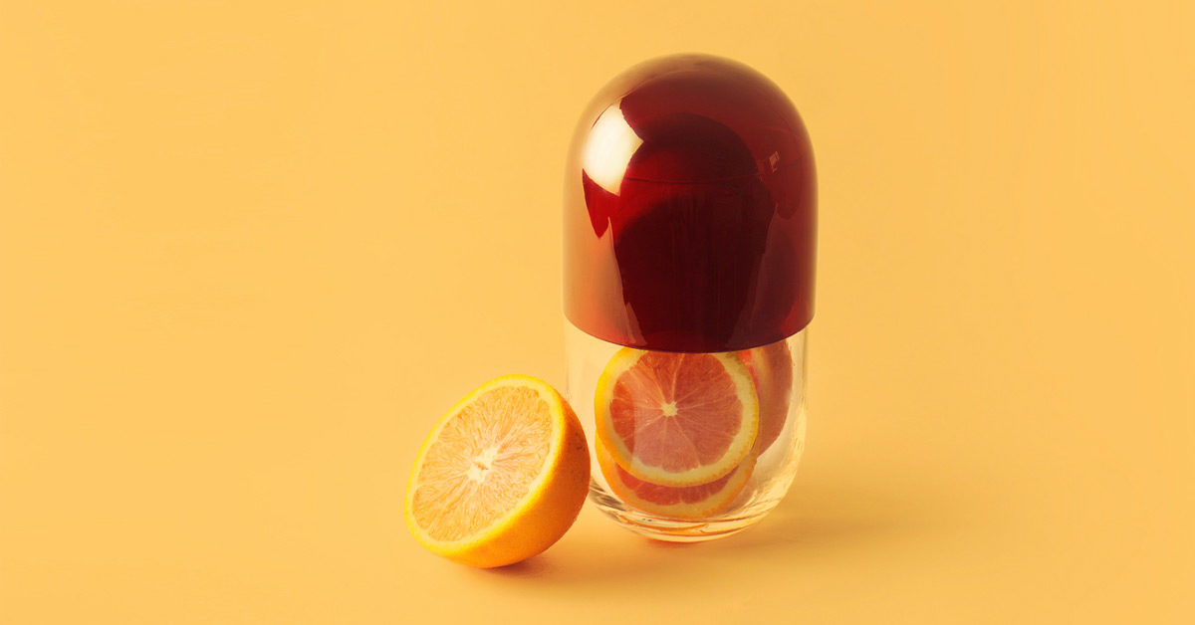
New post template
Michelle
4 hrs
Michelle
4 hrs
...
...
Can you believe how stupid people are? Of course vitamin C doesn’t affect your cold if you start taking it after you develop symptoms.
There is little evidence supporting the idea that Vitamin C has an effect on your cold if you start taking it after you develop symptoms.
Topics: Vitamin
Colds, natural remedies

Slide 72
Ibrahim
3 hrs
...
Ibrahim
3 hrs
...
Can you believe how stupid people are? Of course vitamin C has doesn’t affect your cold if you start taking it after you develop symptoms.
There is little evidence supporting the idea that Vitamin C has an effect on your cold if you start taking it after you develop symptoms.
247
19 comments
247
19 comments
247
19 comments
247
19 comments
Like
Comment
Like
Comment

Slide 73
New post template
Justin
5 hrs
Justin
5 hrs
...
...
Everything comes down to how you nourish your body. Have a migraine? It’s probably because you skipped a meal.
There’s little evidence to suggest that food can trigger migraines, even though many people try diets as a treatment. Skipping meals however is one common trigger.
Topics: Migraine
Natural remedies

Slide 74
Anna Johnson
3 hrs
...
Anna Johnson
3 hrs
...
There’s little evidence to suggest that food can trigger migraines, even though many people try diets as a treatment. Skipping meals however is one common trigger.
Everything comes down to how you nourish your body. Have a migraine? It’s probably because you skipped a meal.
898
50 comments
898
50 comments
5460
21 comments
5460
21 comments
Like
Comment
Like
Comment

Slide 75
New post template
Katya
6 hrs
Katya
6 hrs
...
...
Yeast infections are common in women who take broad-spectrum antibiotics. This is because while antibiotics kill a range of bacteria, they also kill healthy bacteria.
WARNING: ANTIBIOTICS ARE NOT NATURAL! Your body needs healthy bacteria. Taking antibiotics can even give women yeast infections and a whole host of other problems.
Topics: Gender, antibiotics

Slide 76
<
Women’s health support
154 members
<
Women’s health support
154 members
Katya
Yeast infections are common in women who take broad-spectrum antibiotics. This is because while antibiotics kill a range of bacteria, they also kill healthy bacteria.
Katya
WARNING: ANTIBIOTICS ARE NOT NATURAL! Your body needs healthy bacteria. Taking antibiotics can even give women yeast infections and a whole host of other problems.

Slide 77
Javier Matos
3 hrs
Javier Matos
3 hrs
...
...
Aloe vera has a lot of benefits as a topical medication, including treatment for first and second degree burns. Some reviews have shown that it has faster healing times than many conventional medicines.
Don’t be duped by the profit-seeking of big pharmaceutical companies. Aloe vera often fixes burns much faster than conventional medicine.
898
50 comments
898
50 comments
5460
21 comments
5460
21 comments
Like
Comment
Like
Comment

Slide 78
<
Medical #Facts
154 members
<
Medical #Facts
154 members
Oliver Ivanov
Some antibiotics can make you very sick if taken in combination with alcohol, while others might be more safe. Consult your doctor about possible side effects of any drug they prescribe.
Oliver Ivanov
Doctors would NEVER tell you this, but you don’t really need to avoid alcohol. when taking antibiotics. Only certain antibiotics react poorly with alcohol.

Slide 79
Section 2: “Can people use techniques to combat misinformation?”
16 different facts, 12 false, 4 true
12 posts, 1 from each false fact, distributed as follows: 4 tactics - 4 emotions - 4 general misinformation
4 posts, 1 from each true fact

Slide 80
Emotion

Slide 81
New post template
Trushar
4 hrs
Trushar
4 hrs
...
...
They are hiding the truth from you and putting our children in danger. Give your child a tablespoon of garlic and honey each day to prevent measles, not any of the mysterious drugs doctors want to feed to our kids.
Give your child a tablespoon of garlic and honey each day for an effective home treatment and way to prevent measles.
Topics: Vaccine, Children
natural remedies

Slide 82
<
Covid chat
Trushar, Indrajeet, Sundar
<
Covid chat
Trushar, Indrajeet, Sundar
Trushar
They are hiding the truth from you and putting our children in danger. Give your child a tablespoon of garlic and honey each day to prevent measles, not any of the dangerous vaccines and drugs doctors want to feed to our kids.
Trushar
Give your child a tablespoon of garlic and honey each day for an effective home treatment and way to prevent measles.

Slide 83

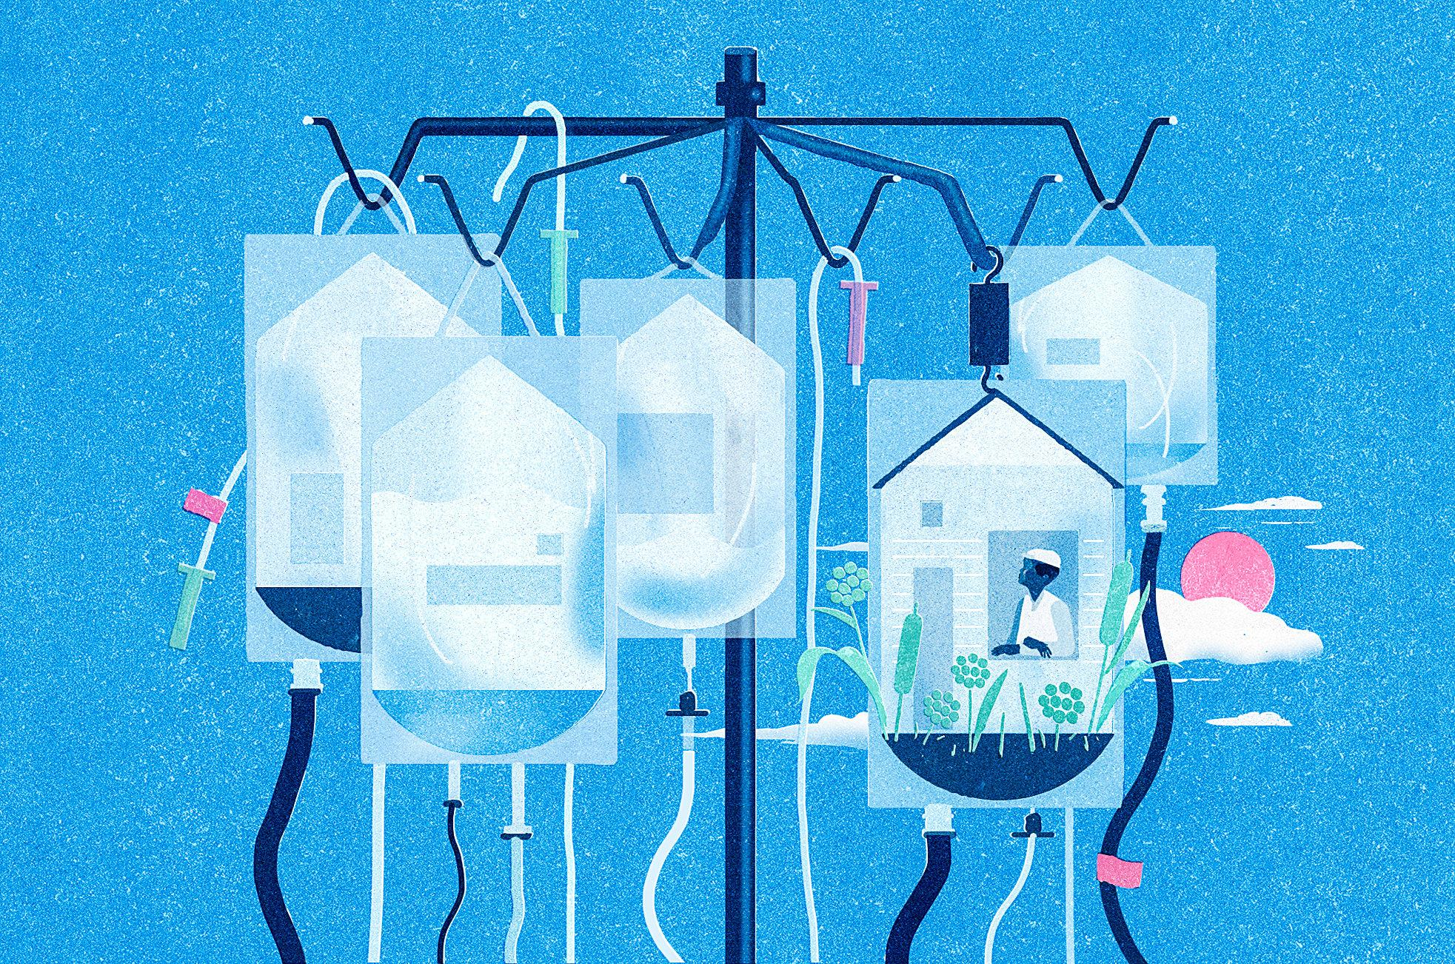
New post template
Smitha_1976
4 hrs
Smitha_1976
4 hrs
...
...
Have you ever considered that Big Pharma might be withholding the cure for cancer so that they can continue making $$$? It’s always profit over everything, even public health.
A huge industry has formed around cancer that generates large revenues with marginal benefits to patients. The costs of cancer have gone up 40% in the last decade.
Topics: Big Pharma, cancer

Slide 84
David_1976
...
David_1976
David_1976 It’s inexcusable how the cancer industry and Big Pharma are withholding the cure for cancer so that they can continue making $$$. It’s always profit over everything, even public health.
...
David_1976 A huge industry has formed around cancer that generates large revenues with marginal benefits to patients. The costs of cancer have gone up 40% in the last decade.
Liked by hansolouw and 540 others
Liked by hansolouw and 540 others
View all 12 comments
2 February 2022
View all 12 comments
2 February 2022

Slide 85

New post template
Dhruv
4 hrs
Dhruv
4 hrs
...
...
Are you pregnant and worried about ensuring the best health of your baby? Drinking a half-liter of coconut water each day while pregnant reduces the chances of birthing complications and results in healthier children.
Drinking a half-liter of coconut water each day while pregnant reduces the chances of birthing complications and results in healthier children.
Topics: Children, pregnancy

Slide 86
Esther
2 hrs
...
Esther
2 hrs
...
Are you pregnant and worried about ensuring the best health of your baby? Drinking a half-liter of coconut water each day while pregnant reduces the chances of birthing complications and results in healthier children.
Drinking a half-liter of coconut water each day while pregnant reduces the chances of birthing complications and results in healthier children.
79
9 comments
79
79
9 comments
Like
Comment
Like
Comment

Slide 87
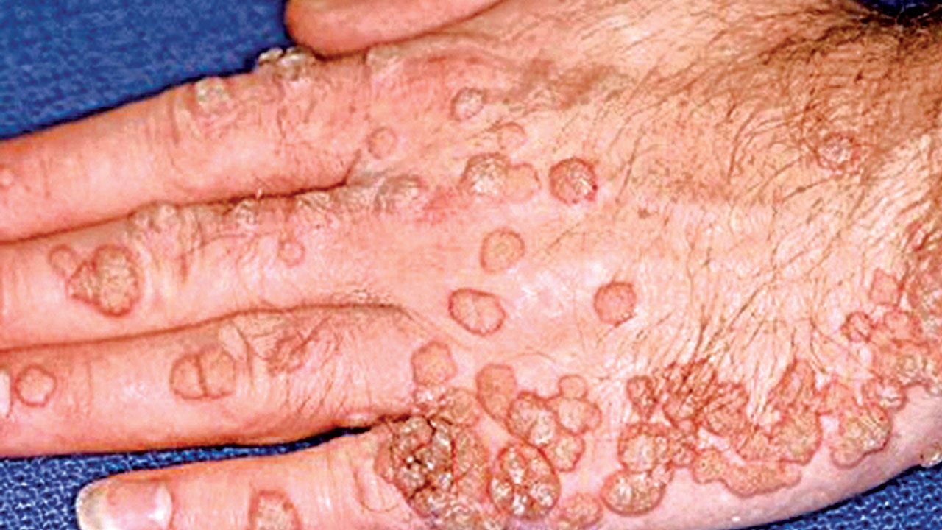
New post template
Andi
4 hrs
Andi
4 hrs
...
...
More countries are expanding the rollout of the HPV vaccine and it could have major consequences for women and their fertility levels.
More countries are expanding the rollout of the HPV vaccine and it could have major consequences for women and their fertility levels.
Topics: Gender, Vaccine
Infertility

Slide 88
Samuel
4 hrs
Samuel
4 hrs
...
...
The wide-scale chemical castration of women is coming as more countries expand the rollout of the infertility-causing HPV vaccine. You should be scared. I am.
More countries are expanding the rollout of the HPV vaccine and it could have major consequences for women and their fertility levels.
330
16 comments
330
16 comments
330
16 comments
Like
Comment
Like
Comment

Slide 89
JohnSands44
2 hrs .
...
They continue silencing us and what we know — Dentists are using dangerous ingredients when they clean your children’s teeth which can lead to a lower IQ.
#savethechildren #knowthetruth #medical choice
330
11 comments
79
9 comments
Like
Comment

Slide 90
New post template
AJ
4 hrs
...
People are falling horrifically ill with tuberculosis after taking aspirin. Protect yourself and do your own research. These drugs are very dangerous.
Topics: medicine
natural remedies

Slide 91
Virtual simulation
Instagram
AZ_Warrior
...
AZ_warrior People are falling horrifically ill with tuberculosis after taking aspirin. Protect yourself and do your own research. These drugs are very dangerous.
Liked by birdy_77 and 120 others
View all 4 comments
18 October 2020

Slide 92

Virtual simulation
Facebook (Feed)
Mohamed Mirza
13 hrs .
...
So we finally know why they want us to get flu vaccines every year. It’s all about collecting our DNA and adding it to their databases so they can easily track and control us.
#DNAfarming #jointheresistance #wakeup
??:?? PM
276
10 comments
79
9 comments
Like
Comment

Slide 93
New post template
Shirley
4 hrs
...
FACT: 8% of all kids 5-10 have dangerous side-effects from the Moderna vaccine. Do your research and protect your children.
Topics: Children, Vaccine

Slide 94
Shely Alam
3 hrs
...
FACT: 8% of all kids 5-10 have dangerous side-effects from the Moderna vaccine. Do your research and protect your children.
5460
21 comments
5460
21 comments
Like
Comment

Slide 95
Tactics

Slide 96
<
WORLD HEALTH NEWS
Daniel, Esther, Sundar
<
WORLD HEALTH NEWS
Daniel, Esther, Sundar
Laura
Very important! One of my best friends, who is a doctor, just published a article about how a diet rich in carrots can prevent diabetes. What good news!
Laura
Very important! I just read a new article about how a diet rich in carrots can help regulate your glucose levels. This is great news for people who are at risk of diabetes.

Slide 97
Ali_1958
Ali_1958
Ali_1958 Look at this. The chart speaks for itself. They have been lying to us but they can’t hide these statistics.
Liked by smitha and 239 others
View all 12 comments
2 February 2022
Liked by smitha and 239 others
Ali_1958 New statistics show that flu vaccine uptake in university students has plummeted in just the last three months.
View all 12 comments
2 February 2022

Slide 98


lindsay_dunne
09:03
Friday 4 February
BREAKING NEWS
A group of researchers claim the common cold is not natural but is manmade, engineered by the US military in 1948 as a bioweapon.
Liked by birdy_77 and 120 others
lindsay_dunne The common cold is not a natural virus. We assume it has always been around because we are used to it, but it was first discovered in humans in 1948. Where did it come from?
View all 4 comments
18 October 2020

Slide 99

Sarah Mwangi
@poojakhurana
15,040 followers 2,039 following
Sarah Mwangi
@poojakhurana
Host of “Medical Science Explained.” Mother of two. Football lover.
Data from the CDC shows that only 7% of recorded covid deaths actually died without other comorbidities. Real covid fatality rates are much smaller than we think.
covid.cdc.gov/covid-data-tr… #covid #coronavirus
15,040 followers 2,039 following
Host of “Medical Science Explained.” Mother of two. Football lover.
Real covid fatality rates are much smaller than we think. Do your own research, all the data is out there for you to make an informed decision.
#covid #coronavirus
3:29 PM - 23 Sep 2020
100 Retweets 964 Likes 223 Comments
1:17 PM - 18 Oct 2020
30 Retweets 250 Likes 24 Comments

Slide 100
New post template
Alice
4 hrs
...
It’s this simple. Sugar causes obesity, which is epidemic. And obesity is a big risk factor for cancer. So obviously sugar is the number one cause of cancer.
Topics: obesity, cancer
weight

Slide 101
Juan Garcia
3 hrs
...
It’s this simple. Sugar causes obesity, which is epidemic. And obesity is a big risk factor for cancer. So obviously sugar is the number one cause of cancer.
357
22 comments
5460
21 comments
Like
Comment

Slide 102
Virtual simulation
YouTube
Do you think it’s a good idea to vaccinate your children?
1,576,674
NO
8,430,222
YES
NEW POLL SHOWS MOST PARENTS AGAINST VACCINES
450,000 views 18 October, 2020 ✓5,6k ✕ 300 →490
Support for vaccines has significantly decreased over the years. A new poll shows just how many parents actually support vaccines for children.

Slide 103
healthprincess
...
healthprincess My friend is a nurse and she just told me about a BRAND NEW piece of research that will be released soon proving that calories have nothing to do with weight or weight loss.
Liked by birdy_77 and 120 others
View all 4 comments
18 October 2020

Slide 104

New post template
Breaking News Daily
4 hrs
...
NEW: After a year-long investigation into the mysterious hospitalizations of several men, it has been discovered that HIV can in fact be transmitted through mosquitoes and other animals.
#breakingnews #breakingnewsdaily #HIV #HIVfacts #IndiaNewsDaily #factaday #sciencenews #STIfacts
Topics: HIV

Slide 105
Breaking News Daily
November 29, 2021
NEW: After a year-long investigation into the mysterious hospitalizations of several men, it has been discovered that HIV can in fact be transmitted through mosquitoes and other animals.
#breakingnews #breakingnewsdaily #HIV #HIVfacts #IndiaNewsDaily #factaday #sciencenews #STIfacts

Slide 106
General misinformation

Slide 107

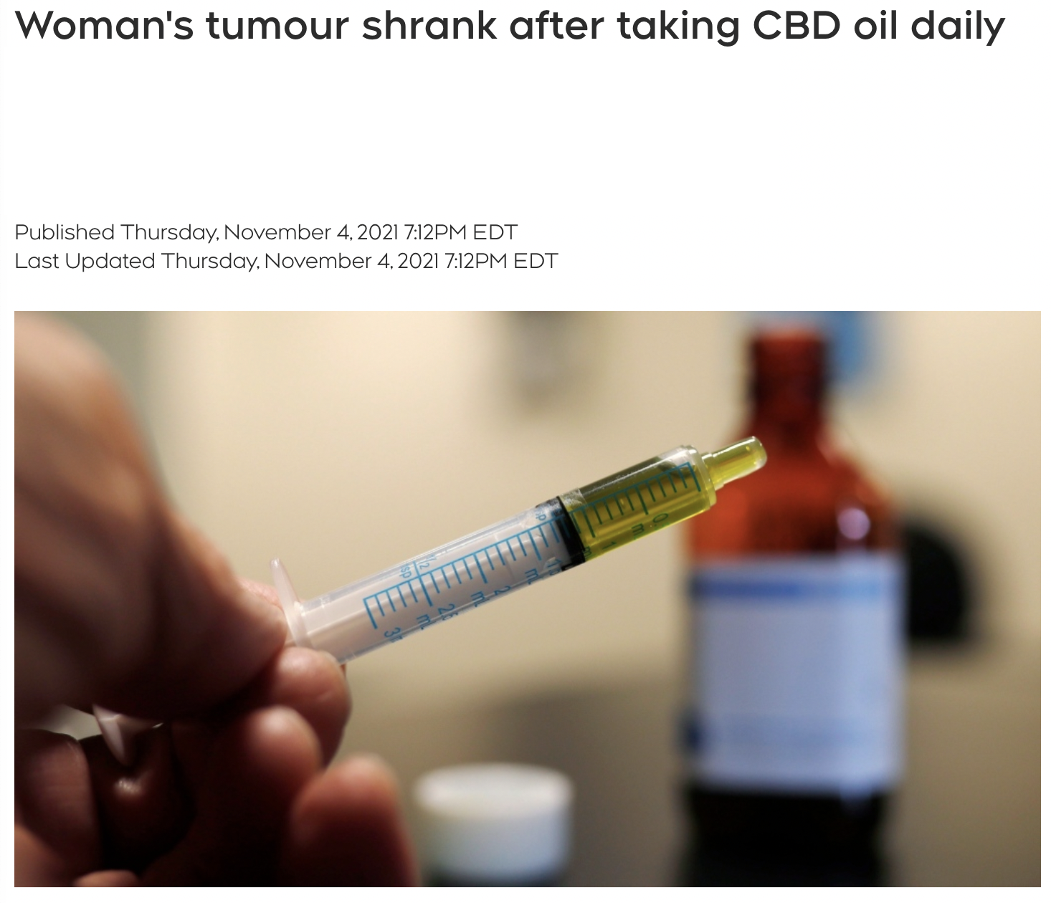
New post template
Topics: cancer, cannabis
drugs
Ali
4 hrs
Ali
4 hrs
...
Woman’s tumor SHRANK after consuming CBD oil daily
New research shows that cannabis consumption makes you less at risk of developing leukemia and other types of cancer later in life.
New research shows that cannabis consumption makes you less at risk of developing leukemia and other types of cancer later in life.

Slide 108
Angel
3 hrs
...
Angel
3 hrs
...
Woman’s tumor SHRANK after consuming CBD oil daily
New research shows that cannabis consumption makes you less at risk of developing leukemia and other types of cancer later in life.
New research shows that cannabis consumption makes you less at risk of developing leukemia and other types of cancer later in life.
323
23 comments
5460
21 comments
5460
21 comments
Like
Comment
Like
Comment

Slide 109

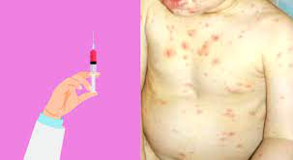
New post template
Michael
4 hrs
Michael
4 hrs
...
...
People who received the chickenpox vaccine are more likely to catch and spread the disease compared to unvaccinated people who were exposed to the disease early in life.
People who received the chickenpox vaccine are more likely to catch and spread the disease compared to unvaccinated people who were exposed to the disease early in life.
Topics: vaccine

Slide 110
<
Vaccine discussion group
Trushar, Indrajeet, Sundar
<
VACCINE TRUTH
Trushar, Indrajeet, Sundar
Indrajeet
People who received the chickenpox vaccine are more likely to catch and spread the disease compared to unvaccinated people who were exposed to the disease early in life.
Indrajeet
People who received the chickenpox vaccine are more likely to catch and spread the disease compared to unvaccinated people who were exposed to the disease early in life.

Slide 111
New post template
John
4 hrs
John
4 hrs
...
...
The Gonzalez Protocol, combining nutritional enzyme treatment and detoxification routines, has been proven to effectively cure pancreatic cancer!
The Gonzalez Protocol, combining nutritional enzyme treatment and detoxification routines, has been proven to effectively cure pancreatic cancer!
Topics: cancer
natural remedies

Slide 112
<
Health nuts
Trushar, Indrajeet, Sundar
<
Health nuts
Trushar, Indrajeet, Sundar
Indrajeet
The Gonzalez Protocol, combining nutritional enzyme treatment and detoxification routines, has been proven to effectively cure pancreatic cancer!
Indrajeet
The Gonzalez Protocol, combining nutritional enzyme treatment and detoxification routines, has been proven to effectively cure pancreatic cancer!

Slide 113
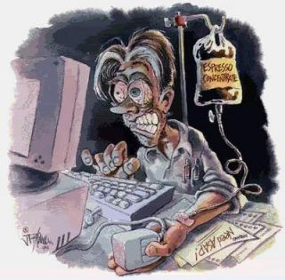
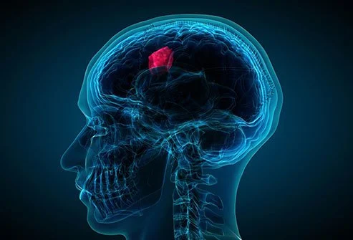
New post template
Topics: cancer
Laura
4 hrs
Laura
4 hrs
...
...
Excessive use of the internet (5 or more hours per day) can precipitate the development of brain cancer.
Excessive use of the internet (5 or more hours per day) can precipitate the development of brain cancer.
Text here are the same? (Not intentional unless pictures are what meant to be manipulative)

Slide 114
Emile Anderson
...
Emile Anderson
...
NilaS_1981 Excessive use of the internet (5 or more hours per day) can precipitate the development of brain cancer.
Liked by cward1e and 965 others
View all 47 comments
2 February 2022
Liked by cward1e and 965 others
NilaS_1981 Excessive use of the internet (5 or more hours per day) can precipitate the development of brain cancer.
View all 47 comments
2 February 2022

Slide 115
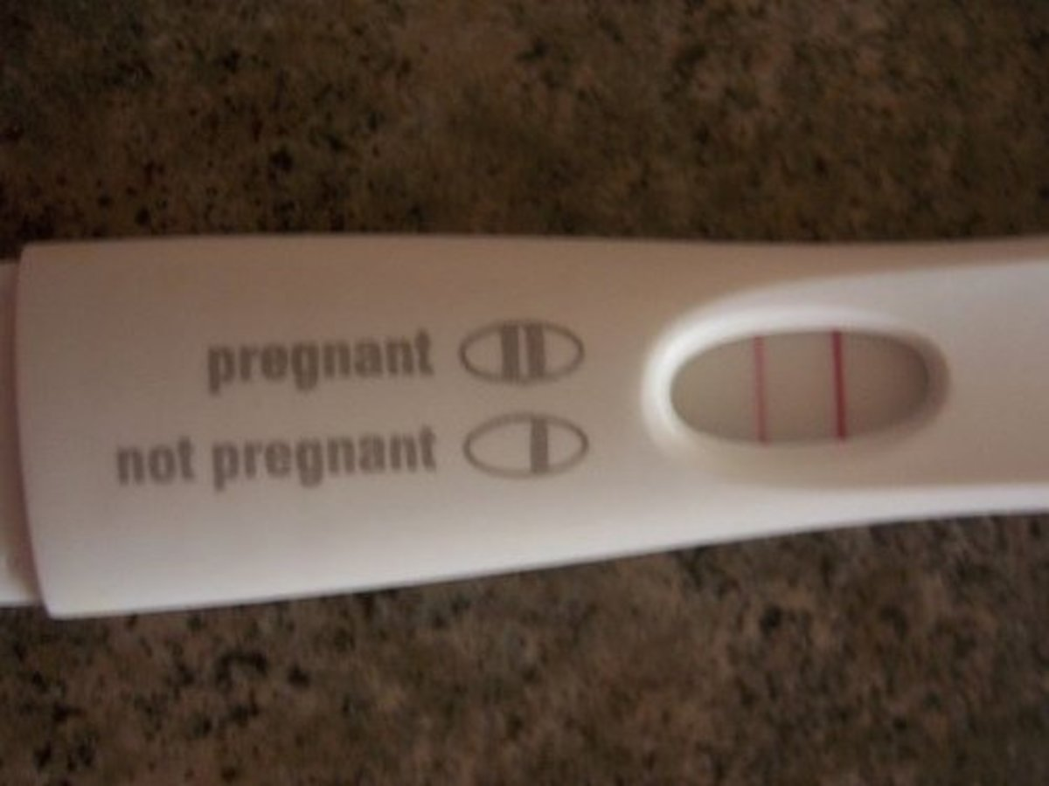
New post template
Lily
4 hrs
...
Certain brands of rapid pregnancy tests should be recalled immediately. Running the tests under tap water returns positive results.
Topics: pregnancy

Slide 116
Ovid da Silva, MD
3 hrs
...
Certain brands of rapid pregnancy tests should be recalled immediately. Running the tests under tap water returns positive results.
228
15 comments
5460
21 comments
Like
Comment

Slide 117
Ovid da Silva
3 hrs
...
Autism is a relatively new phenomenon. There are no known records of it before 1943, when scientist Leo Kranner first described it. Research funded by pharmaceutical companies has attempted to discredit links between vaccines and autism, but the evidence doesn’t lie.
898
50 comments
5460
21 comments
Like
Comment

Slide 118
New post template
Jacquelyn
4 hrs
...
Want to detox your arteries? Taking a bath in epsom salt once a day for a year will clear all the plaque in your arteries and significantly reduce the risk of heart disease.
#healthfacts
Topics: heart disease
natural remedies

Slide 119
Jacquelyn Turner
@jacquelynturner
1,020 followers 1,329 following
Nursing student, bookworm, travel addict.
Want to detox your arteries? Taking a bath in epsom salt once a day for a year will clear all the plaque in your arteries and significantly reduce the risk of heart disease. #healthfacts
1:17 PM - 18 Oct 2020
22 Retweets 234 Likes 15 Comments

Slide 120
New post template
Artha
4 hrs
...
What’s the most effective way to lose weight? Celebrity fitness guru Anna Abramov just showed millions of viewers on national TV how one simple, affordable supplement can help you achieve your weight loss goals.
Topics: obesity (weight)
vitamins

Slide 121
<
Alternative Health
154 members
Artha
What’s the most effective way to lose weight? Celebrity fitness guru Anna Abramov just showed millions of viewers on national TV how one simple, affordable supplement can help you achieve your weight loss goals.

Slide 122
Factually correct

Slide 123
Sunne Kapoor
3 hrs
...
It’s a myth that your heart briefly stops when you sneeze. The fact is, sneezing makes the pressure in our chest change. These small changes can alter blood flow, changing the rhythm of your heartbeat. So even if it feels like your heart skips a beat when you sneeze, it actually doesn’t.
898
50 comments
5460
21 comments
Like
Comment

Slide 124
Virtual simulation
Instagram
JH Public Health
...
JHPublicHealth Global overdose deaths from opioids more than doubled from 1990 until 2017.
Liked by artisharma and 120 others
View all 4 comments
18 October 2020

Slide 125
MYTH: Sitting close to the TV does NOT damage your eyes, but it may cause eyestrain.
5 popular myths debunked!
450,000 views 18 October, 2020 ✓5,6k ✕ 300 →490
Medical doctor Yasmin Ahmadi helps debunk some common myths about health and wellness.

Slide 126
Anna Hardy
@annahardy
13,427 followers 1,534 following
Reporter of “Unknown Truth of Medical Science.” Mother of three.
We need better solutions to solving obesity in communities without access to healthy food. It’s been shown that being overweight may shorten your life, in some cases by a decade or more. #healthinequality #foodaccess #healthyeating #obesity #poverty
Comments from Stanford side:
I think this is similar to a post from before?
4:55 PM - 3 Apr 2020
50 Retweets 230 Likes 55 Comments

